Slide 1
Jui International Women's Day 2017
Advertisement analysis
by
Sanowar Hosen

Slide 2
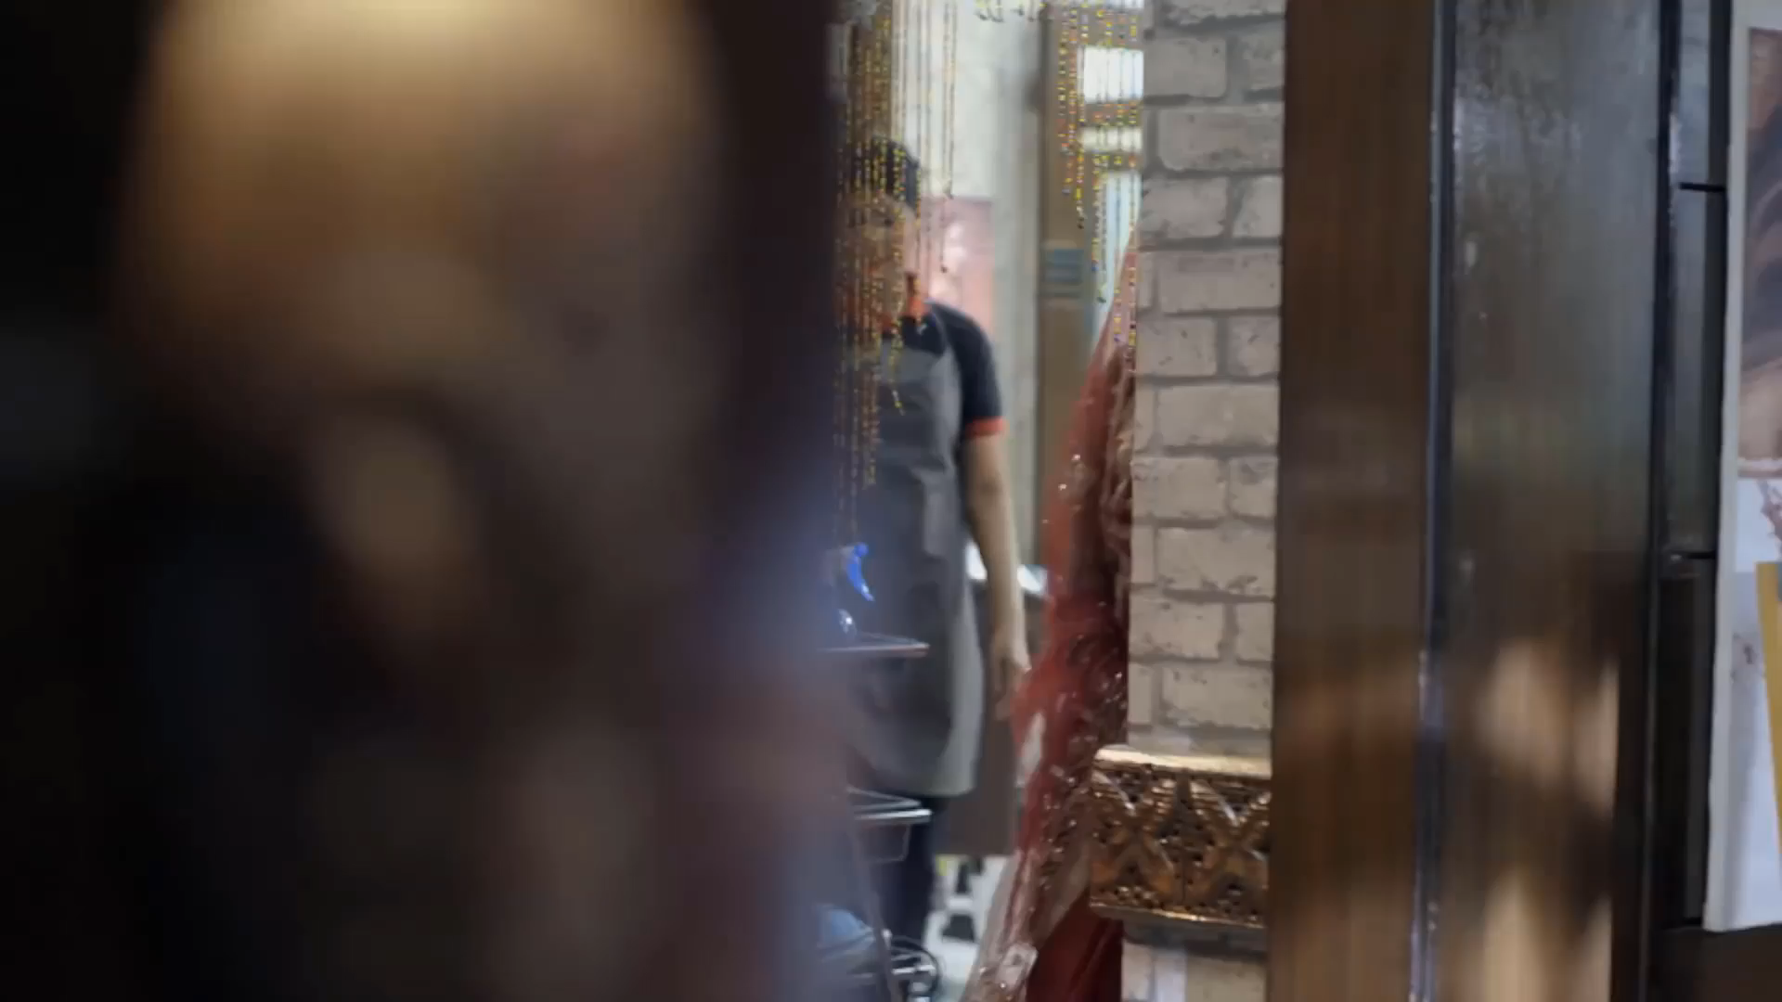
The video in short

Slide 3
Introduction
man dominant society
gender Discrimination

Slide 4
Category
Social

Slide 5
Implicit Meaning
Women being tortured by man

Slide 6
Cultural Significance
Women get less authority, less right than man
Dominated by Man
they don't raise their voice
they tolerate those silently
For example, the women cutting hair without protesting

Slide 7
Ethos and Pathos
Women are hiding agonies within themselves
crates goosebumps
Unethical behavior of men

Slide 8
Target Audience
specifically tortured women
widely mass people

Slide 9
Language
Standard Bangla

Slide 10
Mood
pensive mood

Slide 11
Commercial
Jui coconut oil

Slide 12
Casting style
Video Cast
publish in various platform
YouTube TV

Slide 13
Flaw
Can't reach the targeted audience properly
partial

Slide 14


